Slide 1
Leveraging Grad-CAM for Pruning in the Lottery Ticket Hypothesis

Slide 2
Grad-CAM can be used as a tool for network pruning when applying the lottery ticket hypothesis to deep neural networks. The lottery ticket hypothesis suggests that within a deep neural network, there exist "winning tickets," which are subnetworks that are both smaller and trained from scratch to achieve the same or similar performance as the original, larger network. Pruning is the process of identifying and removing unimportant network weights or neurons to create a smaller, more efficient model.

Slide 3
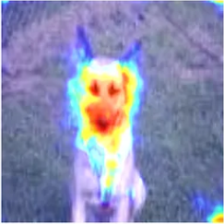
Explainability for pruning
Use Grad-CAM to visualize the importance of various neurons or filters in the network. This visualization helps identify which parts of the network are crucial for making specific predictions

Slide 4
Explainability for pruning
However, there's a critical challenge we face when implementing network pruning: knowing precisely which components to prune. The traditional pruning methods rely on heuristics, fixed thresholds, or layer-wise strategies, which may not always produce optimal results.
Its ability to visualize and highlight the regions of input data that influence specific predictions has made it an invaluable asset for model interpretability.
By utilizing Grad-CAM, we not only achieve efficient network architectures but also gain insights into why certain components are important

